Slide 1
Random Forest Algorithm

Slide 2
Random Forest is about Ensemble Learning
Ensemble learning: combining multiple classifiers to solve a complex problem and to improve the performance of the model
Bootstrap aggregating (bagging) to create an Ensemble.
Bootstrap aggregation (bagging) involves training an ensemble on bootstrapped data sets. A bootstrapped set is created by selecting from original training data set with replacement. Thus, a bootstrap set may contain a given example zero, one, or multiple times.
Inference is done by voting of predictions of ensemble members, called aggregation.

Slide 3
Random Forest is a supervised learning algorithm
Supervised Learning is defined by its use of labeled datasets to train algorithms that to classify data or predict outcomes accurately.
Other examples of supervised learning classifier algorithm:
1. Logistic Regression is a supervised learning algorithm
2. Support Vector Machines
3. k Nearest Neighbor
4. Decision Tree
5. Etc.

Slide 4
Working of a Random Forest
As the name suggests, "Random Forest is a classifier that contains a number of decision trees on various subsets of the given dataset and takes the average to improve the predictive accuracy of that dataset." Instead of relying on one decision tree, the random forest takes the prediction from each tree and based on the majority votes of predictions, and it predicts the final output.
The greater number of trees in the forest leads to higher accuracy and prevents the problem of overfitting.

Slide 5
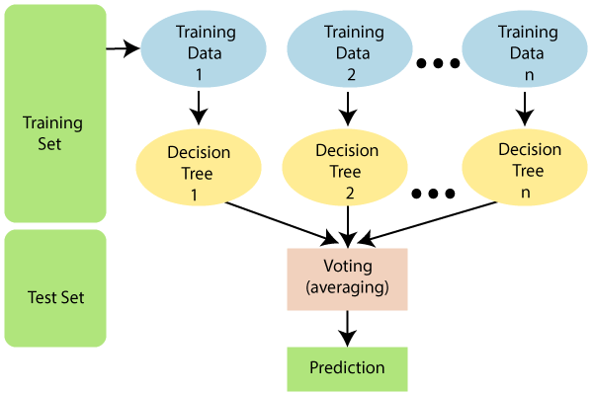

Slide 6
How the prediction is done?
Suppose there is a dataset that contains multiple fruit images. So, this dataset is given to the Random forest classifier. The dataset is divided into subsets and given to each decision tree. During the training phase, each decision tree produces a prediction result, and when a new data point occurs, then based on the majority of results, the Random Forest classifier predicts the final decision. Consider the below image:

Slide 7
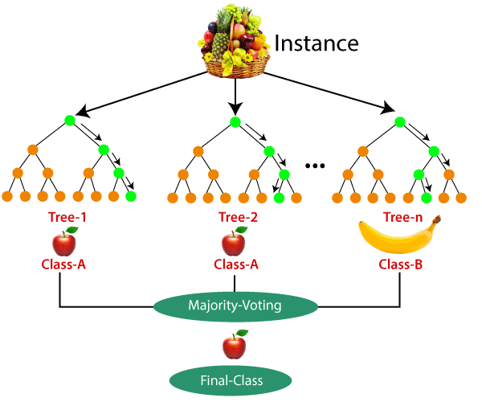
In this image, two decision trees are saying that the fruit is apple while one tree is saying that the fruit is banana.
So by majority vote, we say the fruit is apple.

